Slide 1
Ivan Vagunin
i█an███in@██a██.██
@ivagunin
Threat modeling for SharePoint Online

Slide 2

whoami
@ivagunin
Systems Architect, Digia Plc, Helsinki
Microsoft Certified Solutions Master: SharePoint
Occasional tech community contributor
Independent security researcher
MSRC TOP100 Black Hat 2018

Slide 3
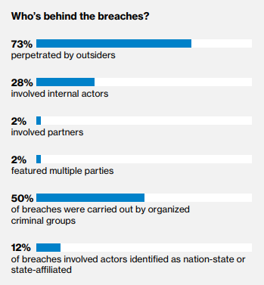
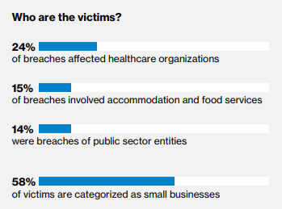
Why care about security?
Data breach investigation report 2018 by Verizon

Slide 4
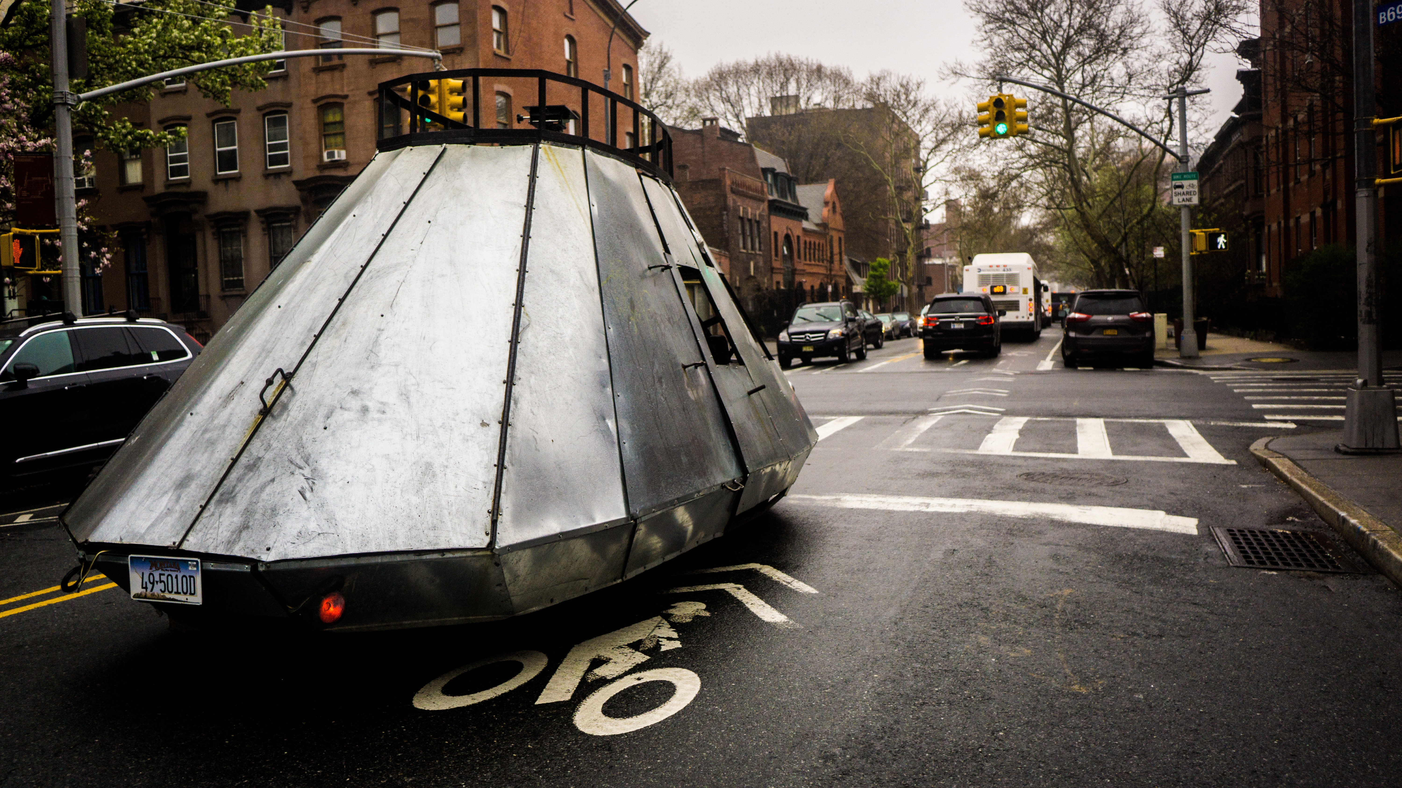

Slide 5
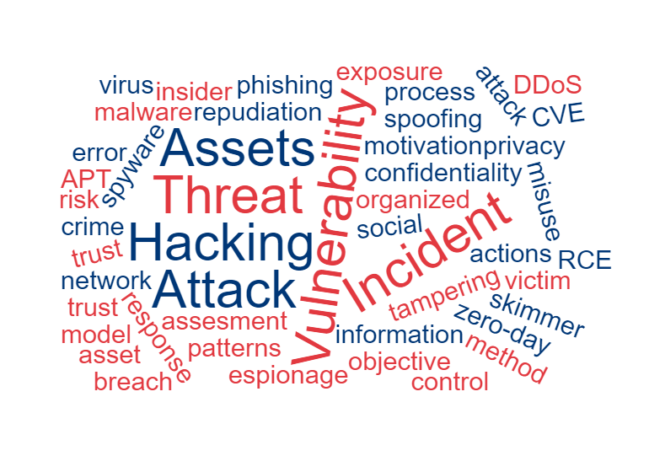
What are the threats?

Slide 6



Threat modeling pieces
Attacker
Asset
System

Slide 7
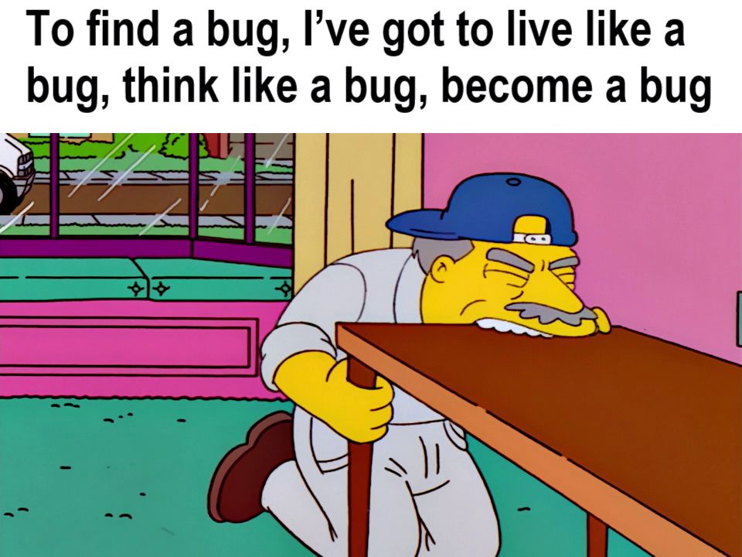
Think like an attacker

Slide 8
Attacker lists and profiles
Competitor
Government cyber warrior
Data miner
Disgruntled employee
Radical activist
Information partner
Cyber vandal
Untrained employee
Sensationalist
Reckless employee
Civil activist
Vendor
Terrorist
Thief
OWASP threat agents
Intel Threat Agent Library (TAL) of Threat Agent Risk Assessment (TARA)
Verizon Data Breach Intelligence Report
Attackers archetypes and personas

Slide 9
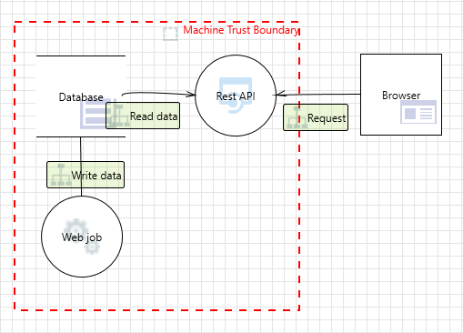
System model
Data flow diagram
Process – code running in the system
Data flow – communication between processes or process and data storage
Data storage – where data rests
External entity – entity out of your control
Trust boundary – boundary where data and execution are trusted

Slide 10
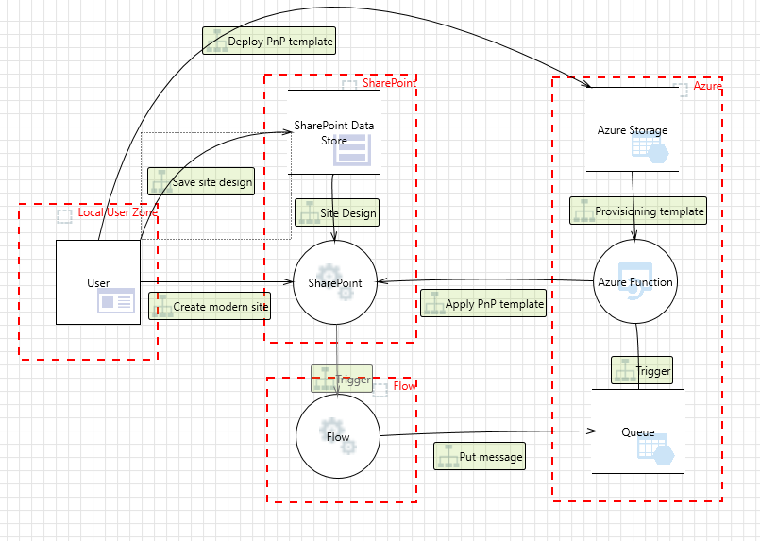
Modern site creation

Slide 11
Attack trees
Access building
Through door
Through window
Roof
Obtain key
Steal key
Make duplicate key
Open lock
Open window
Break window
Use stone
Use glass cutter
Use lock picks
Door is unlocked
Break lock

Slide 12
STRIDE
STRIDE framework for threat enumeration
Spoofing - Pretending to be something or someone other than yourself
Tampering - Modifying something on disk, on a network, or in memory
Repudiation - Claiming that you didn’t do something
Information disclosure - Providing information to someone not authorized to see it
Denial of service - Absorbing resources needed to provide service
Elevation of privileges - Allowing someone to do smth they’re not authorized to

Slide 13
S - Spoofing
Spoof client
No authentication
Backup authentication
Weak authentication
Obtain credentials
Brute force
Transit
Storage
Default credentials
Anonymous access
Downgrade authentication
At client
At server
Knowledge-based authentication
Chained authentication
Information disclosure

Slide 14
T - Tampering
Tampering
Tampering data store
Tampering process
Tampering data flow
Bypass access rules
No integrity
Weak integrity
Corrupt state
Call chain
Caller
Callee
Invalid input
Access to code
Dependency
MITM
Replay
Bypass protection system
Confuse request

Slide 15
R - Repudiation
Repudiation
DoS logs
Tamper with logs
Transaction
No or insufficient logs
Spoof identity
Logs not synced
Deny write
Deny read

Slide 16
I - Information disclosure
Information disclosure
Metadata
Storage attacks
Side channels
Timing
Other
Backups
Logs
Physical access
MMS
Titles
URLs
Error messages
CDNs

Slide 17
D - Denial of service
Denial of service
Corrupt process
Corrupt data storage
Consume application resources
Invalid input
Hold locks
Other
Deny access to store
Exceed capacity
Fundamental
Quotas
Bandwidth
Corrupt data
Corrupt data flow
Corrupt message
Incapacitate channel
Incapacitate endpoints

Slide 18
E - Escalation of privileges
Escalation of privileges
Corrupt process
Input validation failure
Bypass permission check
Physical access
Datastore access
Design issue
Insufficient authorization

Slide 19
DEMO: Threat modeling low trust add-in

Slide 20

Authentication
Computers
IPSec
DNSSEC
Kerberos
PKI
Users
Multifactor authentication (MFA)
Password policies
Session persistence techniques
Disable weak authentication schemes

Slide 21

Integrity
Access control
ACLs
Permissions
File integrity
Digital signatures
Hashes
Network traffic
Tunneling

Slide 22

Non-repudiation
Strong logging
Secured log storage
Strong authentication
Digital signatures
Keep untrustworthy parties oﬀ

Slide 23

Confidentiality
Files
ACLs/permissions
Encryption
Appropriate key management
Network traffic
Encryption
Appropriate key management
Fact of communication
Mix networks
Onion routing
Steganography

Slide 24

Availability
Dynamically allocated resources, cloud services
Input filters and validators
Quotas and thresholds
High availability design
Plan recovery

Slide 25

Authorization
ACLs
Group or role membership
RBAC/CBAC
Principle of least privilege

Slide 26
Other threat enumeration techniques
Attack trees
Methodologies
STRIDE
OCTAVE
PASTA
VAST
Attack libraries and checklists
MITRE’s Common Attack Pattern Enumeration and Classification (CAPEC)
OWASP Top Ten

Slide 27
Managing risks
Avoiding Risks
Addressing Risks
Accepting Risks
Transferring Risks

Slide 28
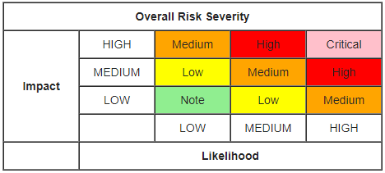
Risk prioritization
Intel’s TARA
OCTAVE
OWASP risk rating

Slide 29
Threat modeling cycle
Create system model/diagram
Enumerate threats
Mitigate threats
Test/validate
Repeat
Find threats
Mitigate
Validate
Create model

Slide 30

Security patterns
Standardized deployments
Cloud services
Web applications
Virtual machines
Defense in depth
Principle of least privilege
Layered architecture
Nested trust boundaries

Slide 31
Thank you
Question?

